Slide 1
Part 4: State of the Art and Beyond
Paola Soto and Miguel Camelo

Slide 2
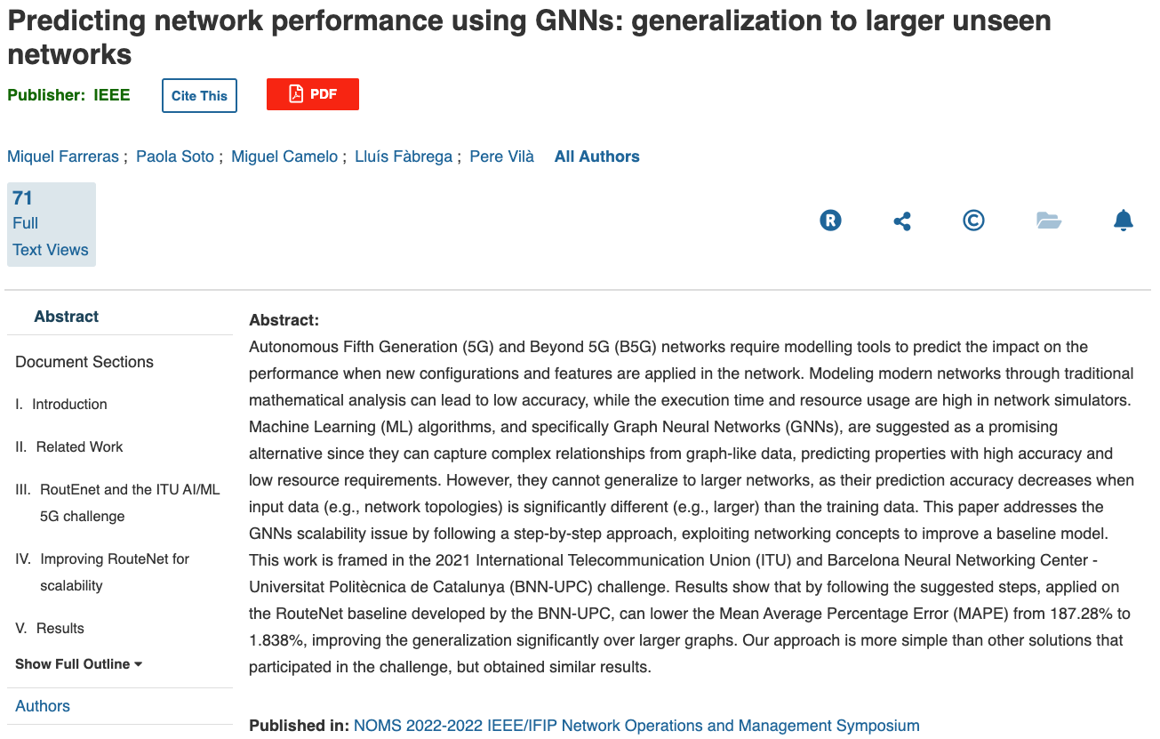
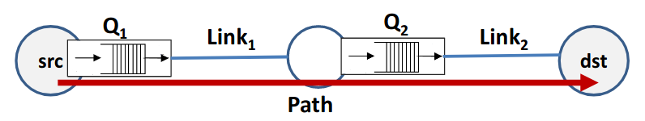
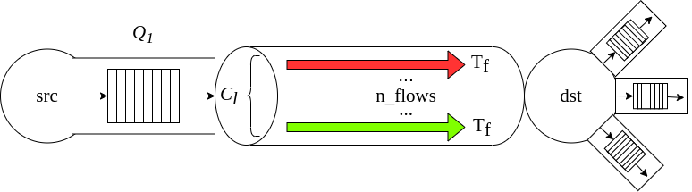
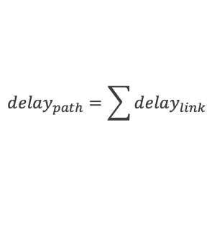
GNNs for wired networks
Predicting delay of large networks
src
dst
$$delay_{path}=\sum{delay_{link}}$$

Slide 3
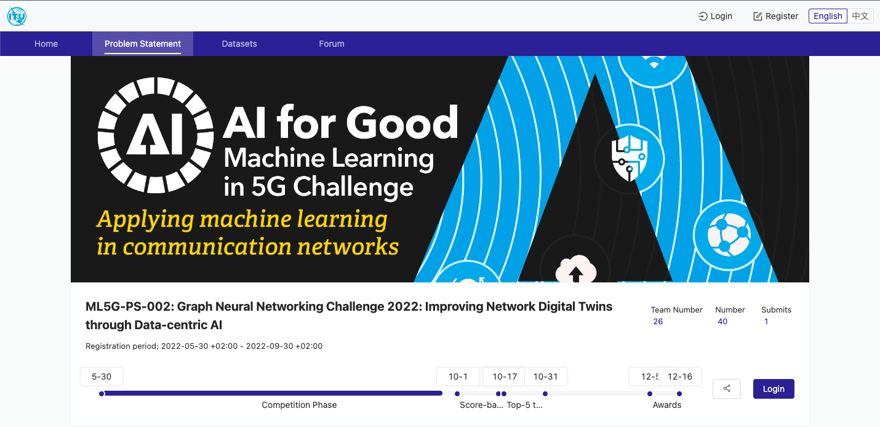



ITU Competition
GNNs as main problem statement

Slide 4
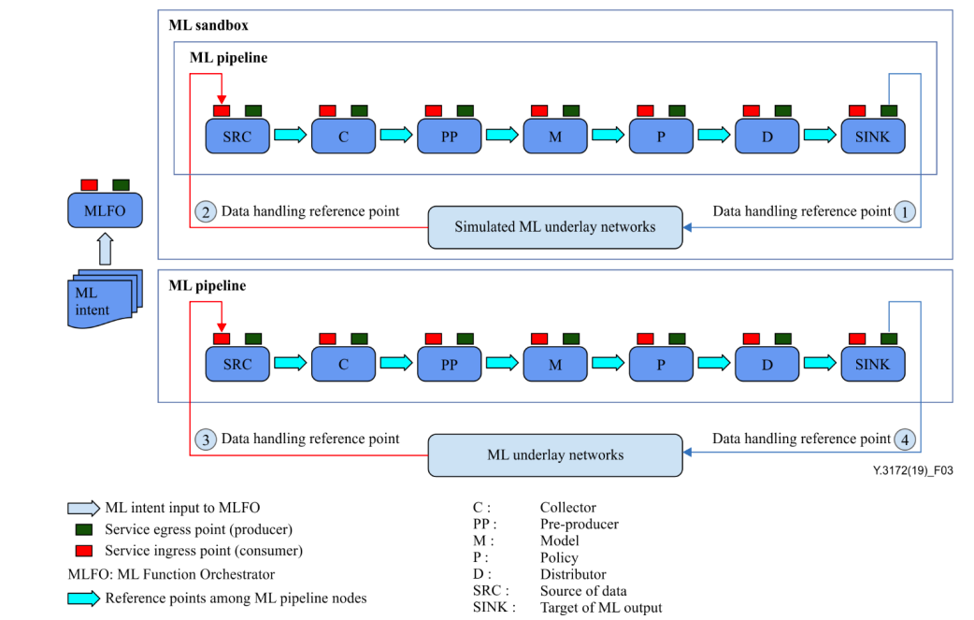
Standarization efforts
ITU
Unified architecture that aims at the integration of ML in 5G and beyond networks.
Given enough accuracy, NDTs can serve as ML sandbox.
Source: ITU-T Rec. Y.3172, “Architectural framework for machine learning in future networks including IMT-2020,” 2019.
Notes:
ML sandbox will have several purposes
serve as a playground for other ML.
generate synthetic data for training
validate potential solutions before being applied in production

Slide 5
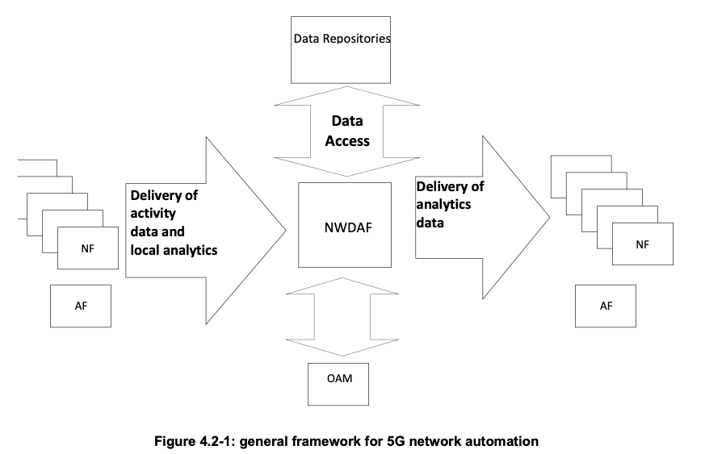
Standarization efforts
3GPP
3GPP contemplates the Network Data Analytics Function (NWDAF).
This function delivers real-time analytics to support the decisions of the OAM system or other NF.
Source: 3GPP TR 23.791 V16.2.0 (2019-06), “Study of Enablers for Network Automation for 5G,” 2019.
Notes:
The NWDAF fits perfectly in the definition of a Digital Twin.

Slide 6
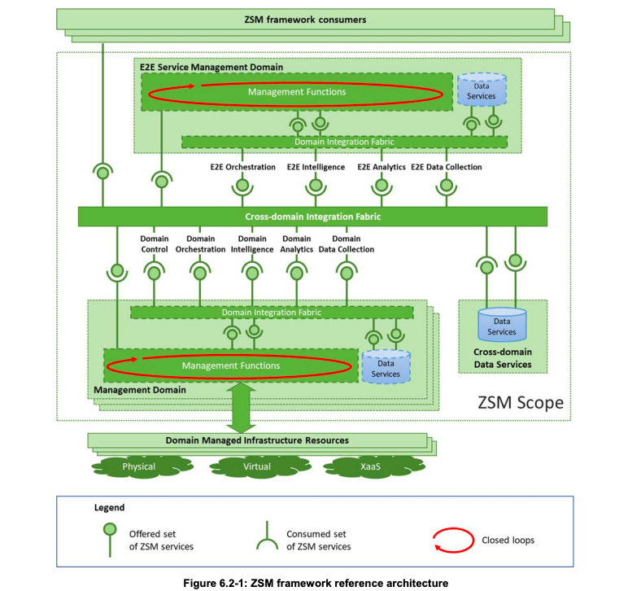
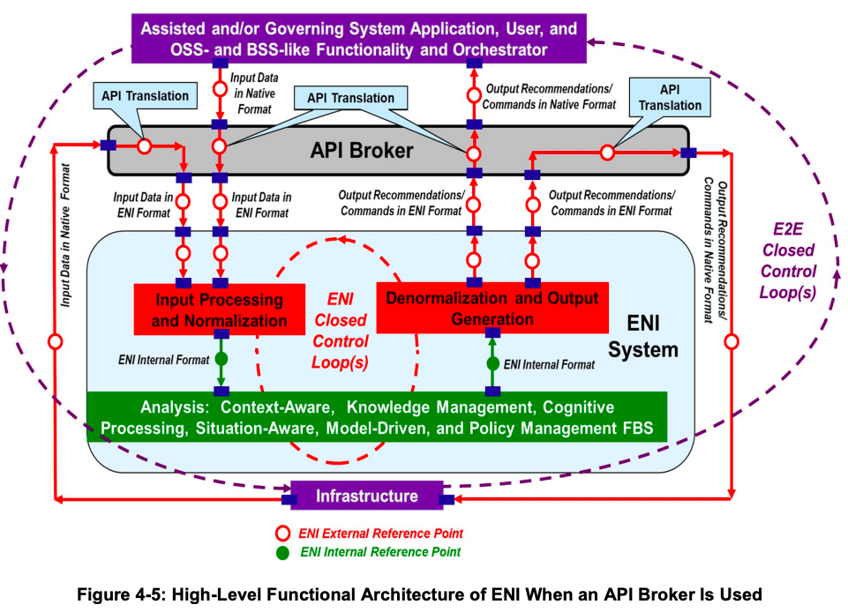
Standarization efforts
ETSI
ZSM
ENI
Source: https://www.etsi.org/deliver/etsi_gs/ENI/001_099/005/02.01.01_60/gs_ENI005v020101p.pdf
Source: https://www.etsi.org/deliver/etsi_gs/ZSM/001_099/002/01.01.01_60/gs_ZSM002v010101p.pdf
Notes:
Other relevant efforts in the networking community are from ETSI.
ENI aims to be a recommender/helper to other systems that could have or not AI integrated in their decisions.
ZSM uses ML to achieve complete automation (no human intervention) in network operation

Slide 7
Useful links
GitHub Repository
Colab NDT – ML
Colab NDT – GNN
Komondor Simulator
Dataset

